Slide 1



THE MUNICIPALITY OF RUMA

Slide 2

VISION OF THE MUNICIPALITY OF RUMA 2030
Ruma is a developed regional center of Srem, which in a sustainable way uses the available resources to achieve economic development and creates favorable conditions for doing business and investing.
Our municipality also represents:
An environment in which satisfied and safe citizens live, who are enabled to participate equally in all aspects of social life.
An environment where residents have equal access to quality education, health, cultural and sports facilities.
An environment characterized by an efficient administration that recognizes the needs of its citizens.
An environment that has an inclusive social protection system in place.
An environment that is favorable for the life of the younger and older population.
The municipality of Ruma takes special care of its natural potentials and environment, with developed communal and other infrastructure, which provides its citizens with access to clean water, clean air and preserved greenery.
.

Slide 3
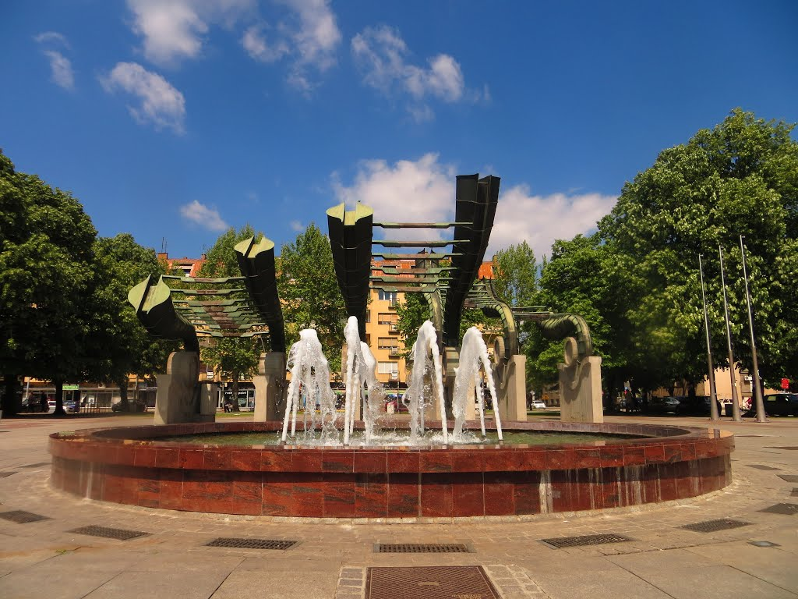
THE MUNICIPALITY OF RUMA
The Municipality of Ruma has an important geostrategic
position.
It is situated in the center of Srem district, between
Danube and Sava, at the foothills of Fruška Gora. Its
area is 582 km².
Population: 54,339
Number of communities: 17
Land use: 74% agricultural area, 13% forests, 13% other
Ethnic structure: 21 nationalities
Number of enterprises: 512
Number of entrepreneurs: 1,560

Slide 4
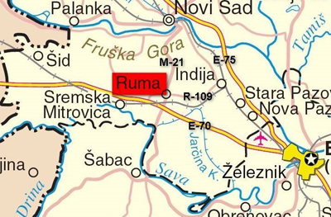
The Intersection of Main European Roads
Comparative advantages of the Municipality of Ruma
There are several factors that create a favorable business climate for economic development of the Municipality of Ruma :
excellent geographical and geostrategic position
adequate infrastructure and reliable utilities,
skilled workforce at competitive rates
developed institutional capacity
excellent investment potential to meet investors’ needs
* (highway E-70), railway Beograd -Zagreb- Beč (27km),
* vicinity of the harbor in Sremska Mitrovica (15km),
* vicinity of the harbor in Šabac (35km)
* vicinity of the airport ,,NikolaTesla"(35km).

Slide 5
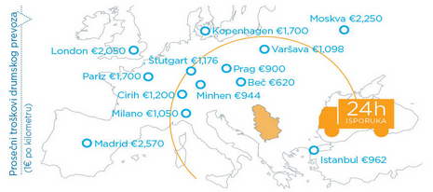
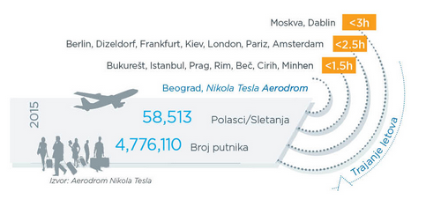
ATTRACTIVE MARKET
Free duty free access to 15% of the world market
Free Trade Agreement with:
* CEFTA (population 30 million)
* Russia (143 million)
* Belarus (10 million)
* Turkey (77 million)
Preferential status:
EU (494 million)
USA (302 million)

Slide 6


QUALITY LABOR
Total number of unemployed: 2431
4 high schools,
12 elementary schools
BETWEEN TWO LARGEST UNIVERSITY CENTERS:
BELGRADE (50 KM) AND NOVI SAD (35 KM)
Experience in specific domains
Competitive salaries

Slide 7
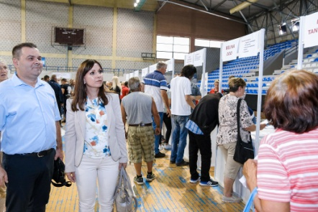
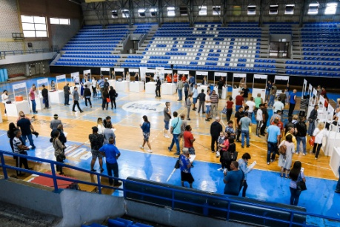
Monitoring of market trends for the local labor and the active relationship to assessed situation and needs
The Municipality of Ruma constantly updates information about workforce.
The employment holds regular meetings.
A survey of the business sector was conducted on the needs of businessmen for labor force educational profiles, to align with the new enrollment policy.
Active cooperation with the National employment agency is reflected in implementation of active employment policy programs and measures.
Since 2005, employment fairs have been a regular activity for the municipality of Ruma. About 9, 000 vacancies have been advertised so far.
New workers at the previous Fair were,among others, sought by companies: ”Hutchinson”, “Albon”, “Cinnovation group”, “ La linea verde”, “Mitas- Trelleborg”... Also, 17 employers took part in the Fair, offering more than 200 jobs.

Slide 8


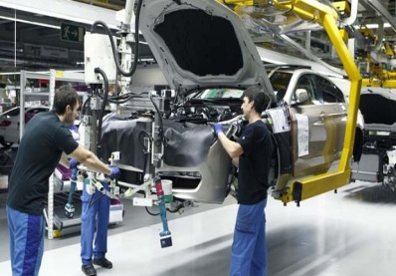

ECONOMIC SECTORS
The most developed economies are:
*Agriculture, (41,000 acres of arable quality land, with 7,000 small farms, existence of secondary agricultural school)
*There are 512 businesses in the municipality companies
*On the territory of the municipality of Ruma 1,683 were registered entrepreneurial actions
By sectors of activity municipalities of Ruma is the most numerous are companies in the field
shops
manufacturing industries
agriculture,
construction
traffic , storage and connection.
*Textile industry (existence of Brownfield facilities suitable for textile production and several successful foreign textile companies)
*Auto industry (existence of several successful foreign companies that produce auto parts, a high-tech high school that meets the workforce needs)
*Leather and footwear industry

Slide 9
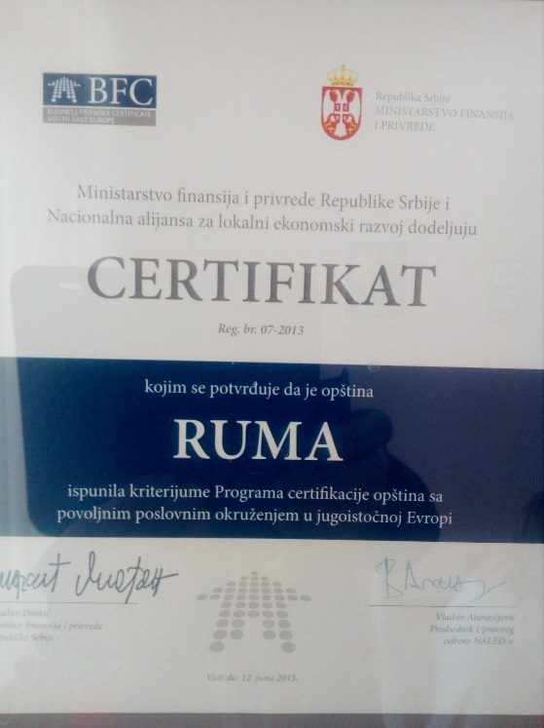
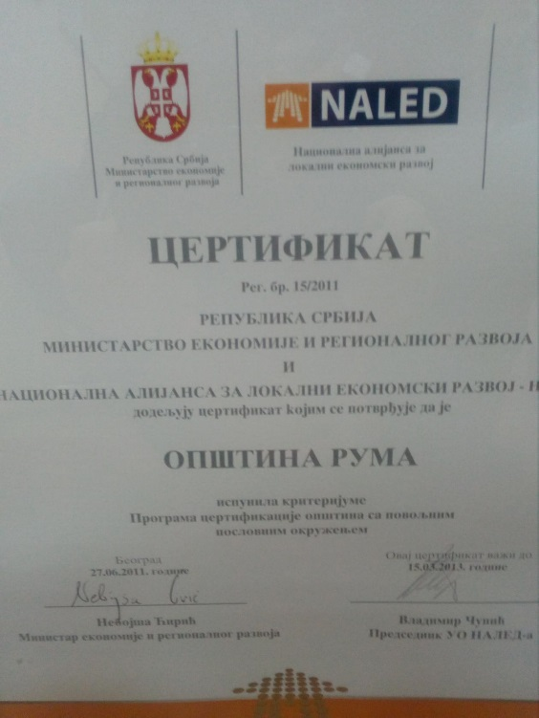
RUMA - A FAVORABLE BUSINESS ENVIRONMENT
In the process of certification, Ruma entered the end of 2009. In April 2021, at the Recertification check, the Municipality of Ruma received confirmation that it achieved the criteria of the Certification Program of cities and municipalities with a favorable business environment in Southeast Europe, in accordance with BFC SEE Edition III standards with 91.00 out of a maximum of 100 percentage points.
NALED most positively assessed the municipal efforts of the Romans, which resulted in numerous positive activities,for example:
The establishment of a business club to address the issues and problems of existing and potential businesses from the municipality.
Regular updating of the database,
Development of new questionnaires,
Surveys for businessmen.
The municipal administration manages to preserve the system and ensure the continuity of its activities by showing an adequate level of motivation, professionalism and efficiency in improving the local economic environment. Employment Action Plan, Commitment of the Mayor to the creation of favorable conditions for the dynamic development of the municipality. One of the significant results is the recognition and evaluation of a realistic image of the local environment by investors and the predictability of the time and money needed to register a company, build a facility, connect to energy and utility systems supply and employment of labor.

Slide 10
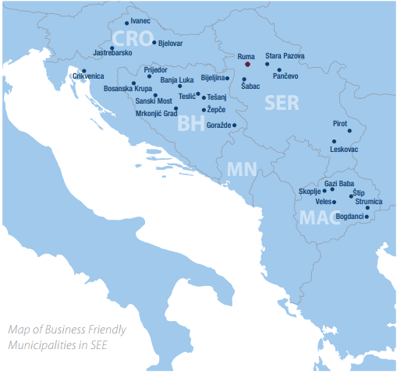

INTERNATIONAL CERTIFICATE ON A FAVORABLE BUSINESS ENVIRONMENT
The municipality of Ruma was among the first local governments in the region to acquire the international BFC SEE certificate, and presented its potentials at the 2015 investment mission in Berlin.
The certificate is a kind of confirmation that the municipality of Ruma is successful in its work, which enables faster and better cooperation with investors, as well as transparent decision-making and development plans.
The Municipality of Ruma has gone through the certification process 4 times and as a result has experienced some expansion in terms of new realized investments as well as an increase in the number of inquiries and interest in investing in our municipality. Ruma is certainly an example of good practice in the region, according the fact that is certified for 11 years.

Slide 11
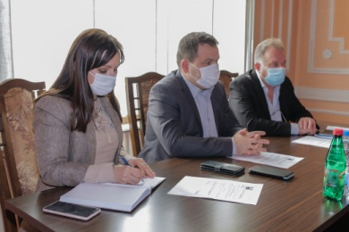
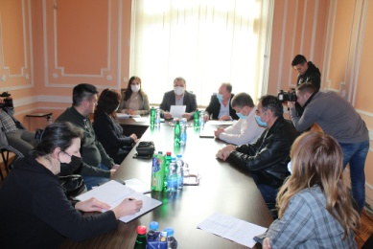
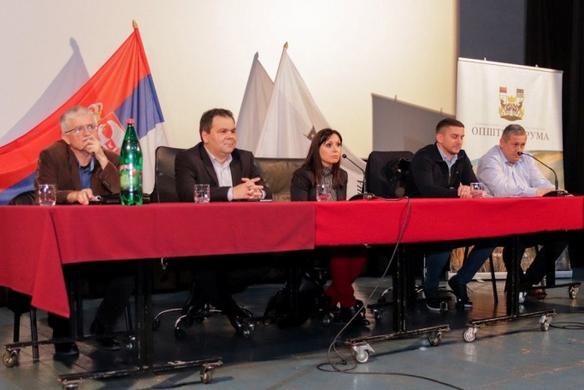
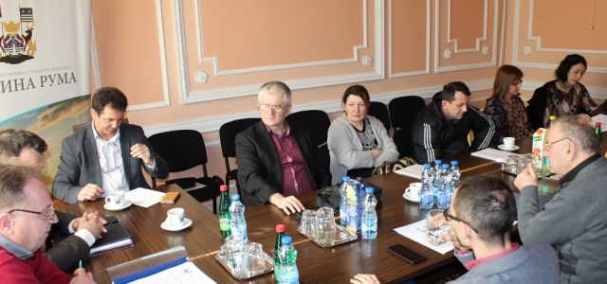
EXISTENCE OF ANALYTICAL BASIS FOR SUPPORTING
A LOCAL COMMUNITY
The Municipality of Ruma actively cooperates with business
Economic council
Social economic council
Consultation with businessmen
The site is regularly updated to find out the views of the population and the economy on different issues from importance for local community development.
On the website of the Municipality of Ruma there is a banner "Invest in Ruma", within which various are available information: city presentation, municipal decisions, strategic plan for sustainable development, local plans, guide to investors, database of business entities.

Slide 12
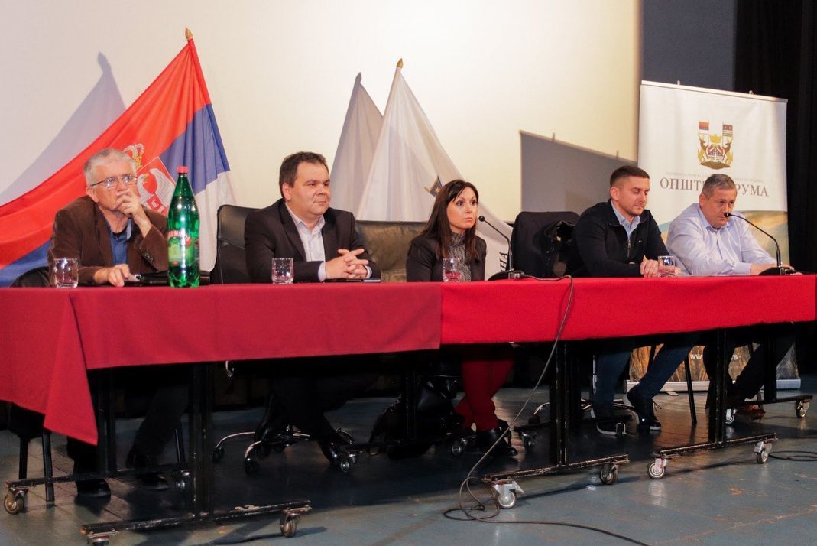
MUNICIPALITY DEVELOPS COOPERATION OF PUBLIC AND PRIVATE SECTOR
Economic Council - the link between local government and the business sector. The primary task is to strengthen the co-operation of local self-government and the economy, with the aim of jointly addressing important issues / problems of general importance for citizens and the economy.
The Economic Council consists of 16 members - businessmen, works and decides collectively and meets once every 3 months.

Slide 13
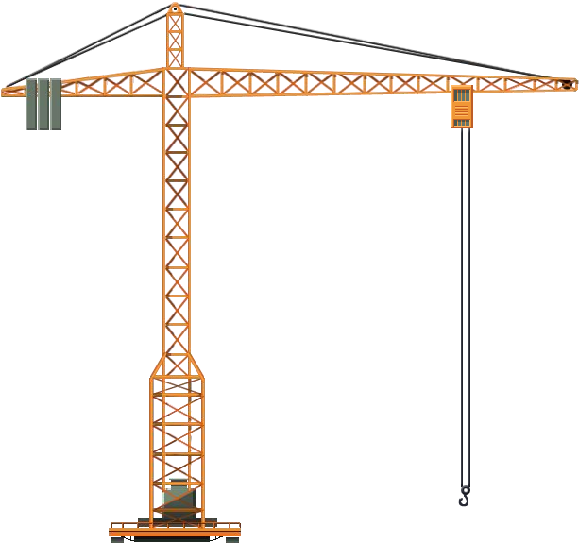
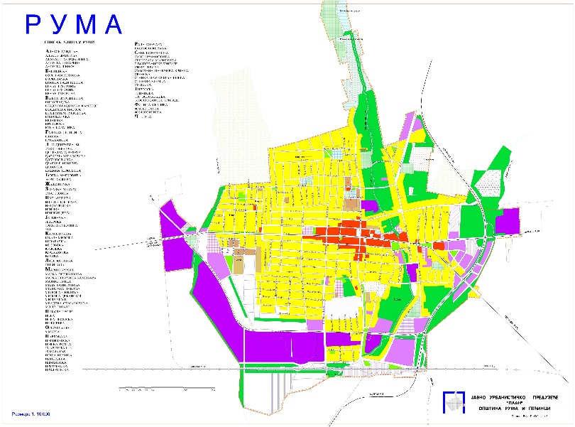
ADEQUATE INFRASTRUCTURE AND RELIABLE COMMUNAL SERVICES
Our Municipality has:
* Medium-term construction editing program land for the period 2016-2021. years
*Annual plans for infrastructural development of Ruma
*Information about each industrial zone and its infrastructure equipment (found in the Investment Sites Catalog).
*Infrastructure information in industrial zones and offers an infrastructure-equipped construction site.
*Data on unit prices of all utilities by type of activity are regularly updated and can be found in the document Table of operating costs in the municipality of Ruma for the economy.

Slide 14
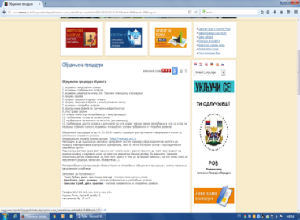
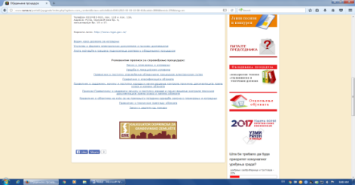
SERVICE SYSTEM FOR OBTAINING A BUILDING PERMIT
*From 01.03.2015. until 01.01.2016. The consolidated procedure was carried out in analog form. From 01.01.2016. year, the unified procedure is carried out within the system for electronic issuing of building permits.
*The Department issues Decisions on building permits and uttility permits in the procedure of unified procedure from 01.03.2015. years.
In 2015, 83 Building Permits were issued,
In 2016, 112 Building Permit were issued,
In 2017, 110 Building Permits were issued,
In 2018, 93 Building Permits were issued,
In 2019, 100 Building Permits were issued,
In 2020, 86 Buildings Permits were issued,
In 2021,92 Buildings Permits were issued,
June 2022,56 Buildings Permits were issued.
Issuance of permits in the unified procedure procedure started on 01.03.2015. years.
The Ministry of Construction, Transport and Infrastructure and NALED awarded the Municipality of Ruma Recognition for their outstanding contribution to the implementation of the electronic licensing system.

Slide 15



SUPPORT PACKAGE
Assistance in cooperation with relevant institutions
Accelerated procedures
Reduced utility taxes based on new employees
Decrease in land price based on the number of new employees

Slide 16


MUNICIPALITY IMPLEMENTS TRANSPARENT TAX AND COLLECTION POLICIES TO INCREASE ECONOMIC DEVELOPMENT
The municipality transparently defines and adopts decisions related to local fees and charges (conducts public hearings on draft decisions).
The opinion of the private sector is taken into account through the Economic Council, the Socio-Economic Council, the Employers Union and other less formal forms of communication.
The municipality offers relief to the economy, for the most part this area is regulated by the relevant republic laws, and the municipality of Ruma within its jurisdiction regulates the property tax coefficient for the territory of the municipality, as well as the average prices per square meter of property for determining property tax for 2022.

Slide 17



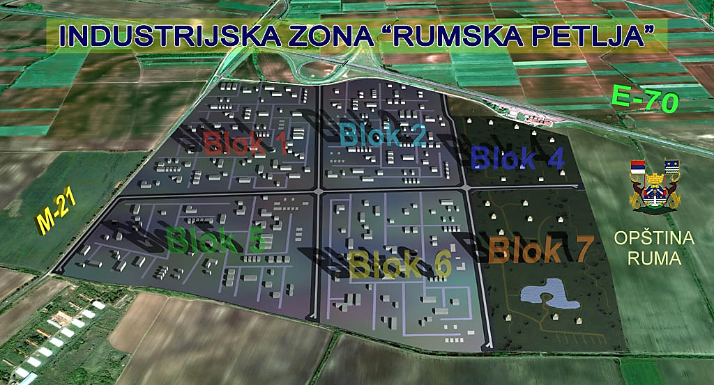








WORK ZONES
The Municipality of Ruma has an excellent geo-strategic position and infrastructurally equipped industrial zones, of which the most notable is the "Ruma loop".
In the previous period, a large number of investments were realized:
In addition to the "Ruma loop", in the Municipality of Ruma there are also work zone East, East 2, West, North, South 1 and South 2, ...

Slide 18
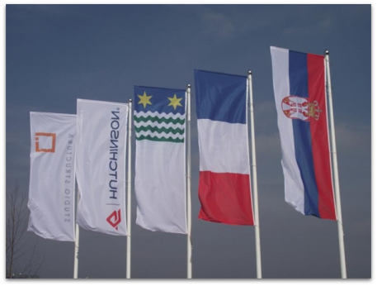
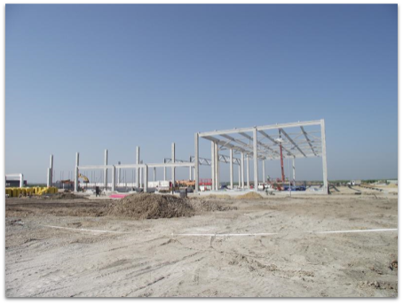
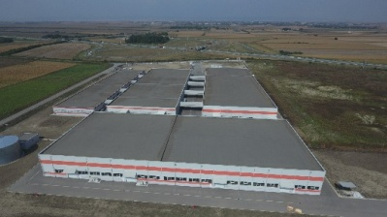
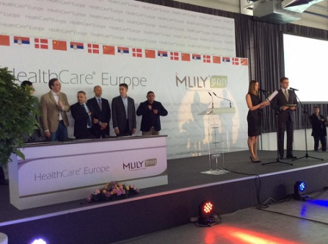


ADMINISTRATION
THE MUNICIPALITY OF ROMA PROVIDED THROUGH PRACTICE THAT IT IS POSSIBLE AND IMPLEMENTABLE TO IMPLEMENT THE INVESTMENT IN A SHORT TIME.
HEALTH CARE EUROPE realized its investment in 10 months
The building permit was issued on August 06, 2014
The grand opening was on June 28, 2015
HUTCHINSON has realized its investment in less than 6 months
Building permit issued September 09, 2015
The grand opening was on February 27, 2016

Slide 19



LOCAL ECONOMIC DEVELOPMENT DEPARTMENT
OLER actively cooperates with institutions of higher hierarchical level (ministries, provincial secretariats), PKS, SKGO, NALED and others.
OLER is responsible for the development of the municipality through various project activities, applying for national, bilateral and EU funds.
OLER has up-to-date databases: database of entrepreneurs, database of business entities, database of domestic investors, database of foreign investors, database of investment sites, database / cadastre of projects.
OLER employees participate in education and training relevant to the work of the department.
OLER prepares promotional materials.

Slide 20



PARTICIPATIVE BUDGETING
The Municipality of Ruma conducted a participative budgeting process. Participative budgeting is a process that involves citizens and other stakeholders in setting priorities and adopting spending plans within the local government budget.
The process took place in several stages:
1. Collection of project proposals
2. Processing the ideas collected, forming a list of projects to be found on the survey questionnaire
3.Final List of Proposals - opinion to the Economic Council, associations to give their opinion
4. Ballot paper
5.Projects with the highest votes
6. Within the sixth cycle participative budgeting process (2021.), three projects have been included in the budget, which will again cover more urban and rural local communities.

Slide 21
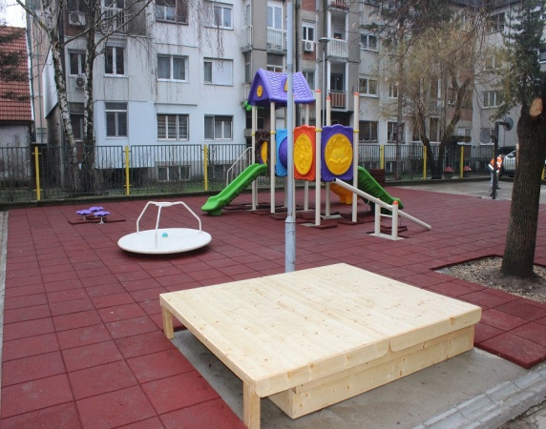
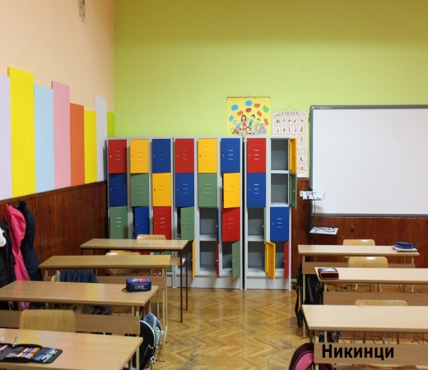
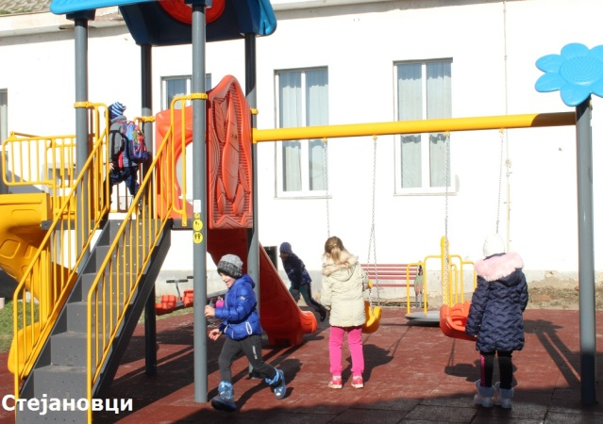
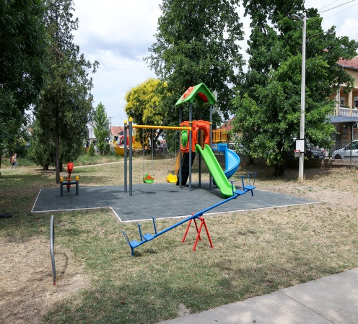
PARTICIPATIVE BUDGETING IN YEAR 2020
-The project of arranging the yard of the kindergarten "Poletarac" - building "Center", for which nearly 1,600 citizens voted, was carried out according to the new rulebook on children's playgrounds and satisfies all safety aspects, and it will be installed multifunctional devices used to improve children's physical development from nursery to preparatory preschool age.
-Lockers for students (Platičevo, Grabovci, Nikinci, Hrtkovci) is a multi-year project that has been realized in phases. First, the lockers were given to the city schools, and then to the village schools, so that now all schools in the territory of our municipality have them.
-Within the project "Participatory budgeting", 10 new modern children's playgrounds have been set up. Playgrounds have been set up at 6 locations in the city and in 4 rural local communities (Grabovci,Vitojevci,Stejanovci and Pavlovci).These are new playgrounds in terms of construction, equipment and surface, the most modern furniture that is made according to the latest standards when it comes to child safety.
- The construction of the pedestrian-bicycle path Donji Petrovci - Putinci (project that was realized in phases) will increase
safety for all traffic users on the local road that connects the two villages. The trail is 1.65 km long.

Slide 22
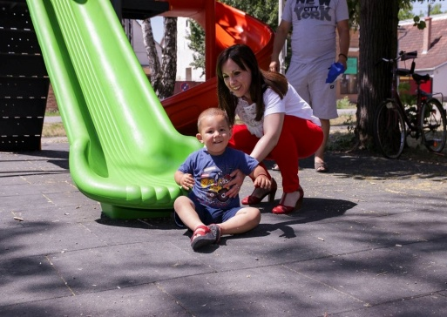
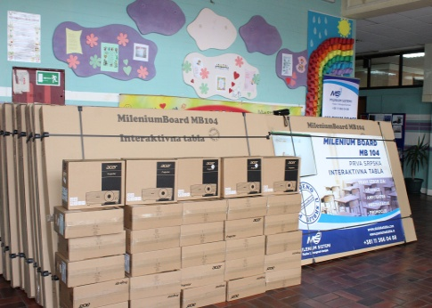
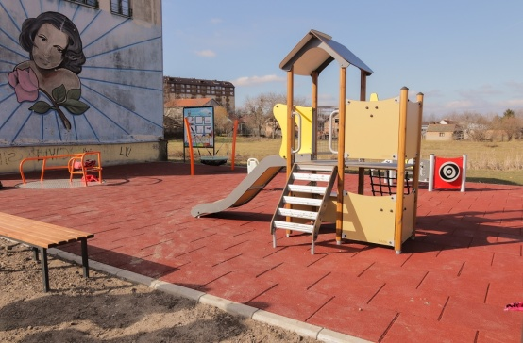
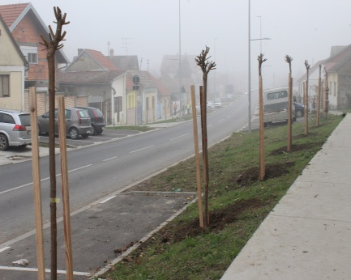
PARTICIPATIVE BUDGETING IN YEAR 2021
-The Smart Boards project for primary schools was realized in such a way that primary schools (4 urban and 7 rural) received the most modern interactive whiteboards for teaching with projectors, thanks to the cooperation of the local self-government and the citizens of our municipality. This proposal received more than 1,200 votes.
Installation of sensor fountains with drinking water at several locations is a project of Participative Budgeting,within which sensor fountains have been installed at public locations in 6 locations in the city. Three fountains offer citizens water at 4 levels: taps for children and people with disabilities, for adults, for filling water bottles and for pets.
The Inclusive Playground project is intended for children with developmental disabilities, which is very important for their social inclusion so that they can play and socialize with other children. The playground is covered with a tartan surface and the equipment is adapted for children with developmental disabilities.
The Tree line arrangement project primarily provides a more beautiful appearance of the city itself and also contribute to the environmental protection and the improvement of people´s health.

Slide 23



SYSTEM 48 - FUNCTIONS 24 HOURS, 7 DAYS SUNDAY
System 48: Service established on April 20, 2011. an intelligent administration and a responsible monitoring system for all its departments and public companies.
Some of the most common problems reported are related to the following :
public lighting, sewage and atmospheric sewage, construction sites, leasing, legalization of illegally constructed structures, requiring various inspections.
1. The problem can be reported by calling a local number, sending an SMS, filling out an online form on the official website or sending an email, or by coming in person to the Municipal Administration building, Orlovićeva br. 5, office no. 20. It is important to note that requests may be sent non-stop, 7 days a week.
2. In 2018, a total of 155 applications were filed and 80 requests were resolved.
In 2019, a total of 178 applications were filed and 99 requests were resolved
In 2020, a total of 145 applications were filed and 86 requests were resolved.
In 2021, a total of 194 applications were filed and 77 requests were resolved.
Depending on to whom the request is addressed and the nature of the request for response, it is waiting from a couple of hours to two to three days.

Slide 24
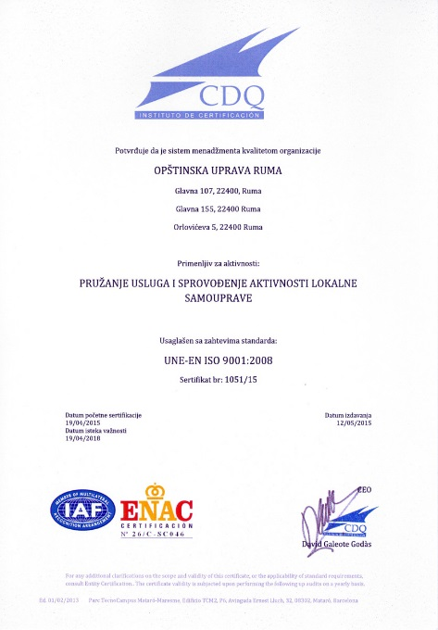
iso standard 9001
The ISO 9001 certificate is the only internationally recognized proof of quality issued by an independent certification body. It is a confirmation that the work of the Municipal Administration is in line with the latest directives and guidelines, but it is also an obligation to regularly monitor the effects of the system and to analyze the situation and possibilities for improving services.
The certificate was acquired on 19.04.2015.
PROVIDING LOCAL GOVERNMENT SERVICES AND ACTIVITIES,
issued by the Certification Institute of Spain (ISDQ)
The quality of service has been improved through :
* A clearly defined quality police
* Better understanding demands of the citizen
* Improve internal and external communication
* More efficient use of time and resources
* Reduction of costs.

Slide 25

RUMA AWARD FOR APPLICATION OF THE GOOD GOVERNANCE PRINCIPLE
The Commission for Selection of Best Practices in the Field of Good Governance at the Local Level has adopted the Decision on Award Winners, intended for cities, municipalities and city municipalities, which in 2018 contributed most to the development and application of good governance principles in their territory.
In the area of ​​"Transparency and public participation in the work of local self-government", the first prize was won by the Municipality of Ruma.
The award was presented by the Ministry of State Administration and Local Self-Government and the Permanent Conference of Cities and Municipalities - the Union of Cities and Municipalities of Serbia (S) within the project "Improving good governance at the local level".

Slide 26

THANK YOU FOR
YOUR ATTENTION
Municipality of Ruma
Glavna 155, Ruma
Department of Local Economic Development
ruma.razvoj@gmail.com
www.ruma.rs

